Slide 1
Veterans Health Administration
Engagement Levels

Slide 2
Introductions – Your Support Team!
Amber Sprague
Lindsay Jaremba
Program Manager
Implementation Strategist
Account Owner/Manager
Jordyn Elwell
VA Care
VA Care
Engagement Coordinator
Madalyn Budzik
Material Orders
Course Logistics
Assessments
vacare@franklincovey.com
Phone: (801) 817-8770
Any technical issues
Login support
Requests for support
Content Subject Matter Expert
Helps to develop long- lasting L&D strategy plans
Develops relationships with key players
Strategic Partner for Contract
Develops relationships with key players
EMAIL
EMAIL
EMAIL
Project Manager
Monthly Reporting
Contract Deliverable Tracking
EMAIL

Slide 3
Who is FranklinCovey?
We are the most trusted leadership company in the world.
We help organizations achieve results that require collective behavior change.
Everything we do is designed to help you succeed in four key areas:
Develop exceptional leaders at every level
Instill habits of effectiveness in every individual
Build an inclusive, high-trust culture
Use a common execution framework to pursue their most important goals.

Slide 4
What do you have access to?
As part of the VHA enterprise-wide contract, every VHA full time employee now has access to FranklinCovey’s All Access Pass. This includes:
Microlearning
Skill-specific Micro Courses
Actionable microlearning pushed to learner via newsletter
Self-selected by learners and/or assigned by VHA
Impact Journeys
Full course delivery facilitated live in-person or live online.
OnDemand/blended learning paths.
Application challenges and automated reinforcement
Can be organized as cohort learning
360 Assessment
Holistic diagnostic on 30+ skills with self-led review.
Option for FranklinCovey Coach-led review of 360 results
Can be used within Impact Journeys or to guide a learner to individualized learning resources.
Content
Virtual Certification for VHA internal facilitators
Free Digital Downloads for facilitator & participant
Discounts on hard copy materials and FranklinCovey Consultant deliveries

Slide 5
Levels of Partnership Engagement
Each Facility and/or VISN has unique learning & development goals. The levels of engagement below are suggested ways for partnering with FranklinCovey to meet your unique needs.
Level 1
Level 2
Level 3
Level 4
Basic
Marketing/Advertising FranklinCovey Resources
Host Super Chats/Overviews
of the Impact Platform
Intermediate
FranklinCovey
Lunch & Learns
Incorporating FranklinCovey content into daily, weekly and/or monthly operations
Advanced
Facilitator Certification
Instructor-led Course Delivery
Utilization of FranklinCovey resources for learning & development needs
Expert
Leadership Development Program Engagement
Up to and including:
Launch 360 Diagnostic
Instructor-led Course(s) Delivery
Utilization of FranklinCovey resources in program development
Blended/Flipped Classroom Learning
Click on each level for more detailed support for executing at each level

Slide 6
Level 1: Basic Engagement
Marketing and Advertising
FranklinCovey Resources
The Basic level of Engagement for the FranklinCovey Partnership is to make sure FranklinCovey Resources are marketing and advertised to VHA employees and that learners have attended an overview/super chat of the resources.
Market FranklinCovey Resources (VIA newsletters, SharePoint, Email, Meetings, etc)
Set up or attend FranklinCovey Overview/Super Chats of the Resources available (set up more overviews for people to register and list them out here)
Marketing and Understanding
FranklinCovey Resources
Marketing Materials to use:
VHA Website : Please bookmark this website as this is where learners/Admins will log on and have access to VHA resources
Email Template for communicating how to get started with the Impact Platform
Get Started Guide for learners
HR & Marketing Resource Center: This link has lots of materials you can use as an Educator
Impact Platform Overviews:
Register for one of our FranklinCovey Impact Platform Super Chat/Overviews on the VHA Website
Reach out to Lindsay.Jaremba@FranklinCovey.com to set up your own overview with people from your VISN/Facility

Slide 7
Level 1: Basic Engagement Below is an email template that you can use to communicate Getting Started with FranklinCovey on the Impact Platform
Communication template
Announcing access to FranklinCovey Impact Platform with Learners
Hello [Learners]:
We have invested in a relationship with FranklinCovey to support the development of our people. FranklinCovey helps create behavior change at scale in the four areas that matter most to our long-term success: leadership, individual effectiveness, culture, and achieving strategic goals.
How to get started with FranklinCovey Impact Platform:
1. Visit https://app.franklincovey.com/
2. Enter your va.gov email address
3. If you are directed to input your password and you either a.) have not set a pass yet, or b.) do not remember your password, click “Forgot password?” and follow the prompts.
4. Here is an Introduction to the FranklinCovey Impact Platform
Tip: Bookmark the site for easy access. Please reach out to VACARE@FranklinCovey.com if you have questions or need assistance accessing the FranklinCovey Impact Platform.
Personalize your Impact Platform Learning Experience:
The moment you log in as a new learner, you are greeted with three simple questions to begin your personalized FranklinCovey learning experience. It’s as easy as 1-2-3! Please feel free to visit our Onboarding Resources for more information.
FranklinCovey will be hosting Super Chats/Impact Platform Overviews that you can join for live direction on how to navigate the Impact Platform as a learner. To register for an upcoming Super Chat/Overview, please on the VHA Website.
Please contact [insert name/e-mail] if you have any other questions or need assistance. For Impact Platform Assistance, you can reach out to VACare@FranklinCovey.com.
Thank you!

Slide 8
Level 2: Intermediate Engagement
FranklinCovey Lunch & Learns
This level encourages Educators, Supervisors, Trainers, etc. to have short Lunch & Learns and/or meetings to share and discuss content. Bringing content in already scheduled meetings is great way to engage at this level.
Examples of ways to use content in meetings from anywhere to 15 minutes to 1 hour:
Pull articles/videos from the Explore Tab on the Learner Platform. You can click the tiles under the Skills section to explore many different articles/videos that fall under that specific skill. (5 min – 1 hr total)
Utilize the Exercises in each Featured Course we have. These can be found in the additional resources section in each Featured Course. (15 min total)
Utilize content from a Microcourse to do a 3-part Lunch & Learn Series – Microcourses are 3-weeks long/30-45 min each week. You could take the content from each week to review and discuss in groups.
FranklinCovey Lunch & Learns
Here are some suggested Exercises that we recommend:
Exercises are 15 minutes long, including discussion
Facilitator can play video for the group, then download the PDF Takeaway document to go over application, reflection and discussion talking points.
The 7 Habits of Highly Effective People: Paradigms Exercise: Paradigms
Unconscious Bias: More Than You See Exercise: More Than You See
Unconscious Bias: All of Us Exercise: All of Us
The 7 Habits of Highly Effective People: Big Rocks Exercise: Big Rocks - 7 Habits
Working at the Speed of Trust: Car Talk Exercise: Car Talk
If you would like support in getting a customized Lunch & Learn/Meeting Series Guide, please reach out to Lindsay.Jaremba@FranklinCovey.com

Slide 9
Level 3: Advanced Engagement
FranklinCovey Facilitator Certification and Course Delivery
This level encourages Educators, Supervisors, Trainers, etc. to get certified in FranklinCovey courses to deliver content to specific groups of VHA employees.
FranklinCovey Facilitator Certification:
Any VHA employee can get virtually certified in our featured courses to facilitate to VHA employees. Once you are certified in any course, you are free to start delivering them.
Click this link for a step-by-step guide to getting certified and best practices for course delivery: Facilitator Certification Process
Click Administrator Help or Facilitator Help for more resources
FranklinCovey Resource Utilization for
Learning & Development Needs
This level also encourages Educators, Supervisors, Trainers, etc. to utilize resources when there are specific learning & development needs that arise in any VISN and/or Facility.
Here is an example of how one might utilize our resources:
Issue: Your facility needs has an issue with trust between Individual Contributors and Supervisors.
Solution:
To have Supervisors go through Leading at the Speed of Trust OnDemand course
To have Individual Contributors go through Working at the Speed of Trust OnDemand course
To do a series of Lunch & Learns or bring content to already scheduled meetings that focus on Trust Building. Areas to pull content from on the Learner Platform:
Earning Trust
Extending Trust
Psychological Safety
Building Trusting Relationships
Managing Up & Across
Please reach out to Lindsay.Jaremba@FranklinCovey.com if you need help putting together a Learning & Development plan for any specific need.

Slide 10
Certification, Delivery & Post-Delivery Follow-Up

Slide 11
Getting Certified & Leading Instructor Led Training
FranklinCovey offers Two Options for certification:
OPTION #1
OPTION #2
Included in the contract is the ability for internal VHA staff to obtain fully virtual, self-paced certification. There is no cost for this option and the process for certification and delivery of content is described in the following slides.
If you prefer live-certification or facilitator excellence training, hosted by a FranklinCovey consultant, please contact Amber Sprague to discuss options and pricing.
Amber Sprague – Client Partner: Amber.Sprague@FranklinCovey.com

Slide 12
Virtual Certification Process
Observe and Participate
Put on your Facilitator Hat!
Review
Notify VACare
Attend an Instructor Led Session as a Participant.
If you are unable to do this, simply watch the virtual certification videos once through with a participant kit and from the learner perspective.
Watch all virtual certification videos with your facilitator kit open (can be digital or hard copy facilitator kit).
Essential Videos
Supplemental Videos
Certification Videos
Delivery PowerPoints
Facilitator Guide
Participant Materials
Work Session Videos
Reporting is critical to ensuring the success of this contract. Please notify vacare@franklincovey.com with the following information:
Name
VISN & Facility/Program Office
Content Area
Date Completed
VACare will send you a certificate of completion.
Most certifications take approximately 20 hours to complete.
This includes all videos, documentation review, session participation, and facilitation practice.
FranklinCovey also offers a Facilitator Excellence program that can be delivered to your facilitators. Reach out to your support team for more information. *Additional Charge*

Slide 13
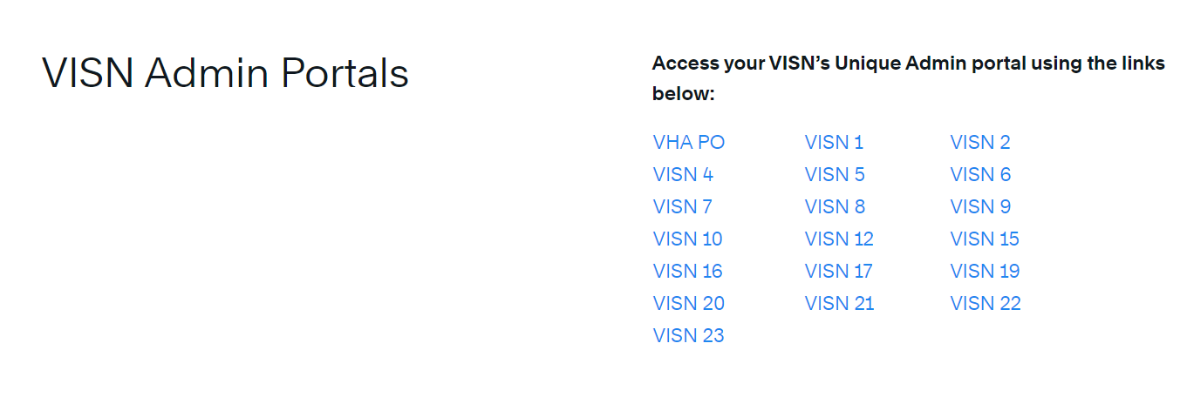
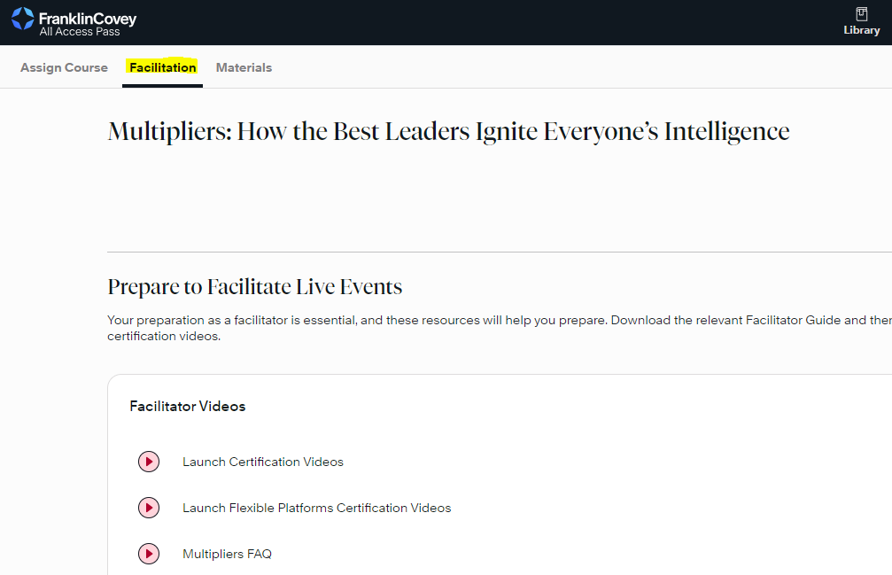
How To Access Facilitator Certifications & Materials
Step 1: Log into your Admin Platform VISN URL
NOTE: The Learner Platform is SEPARATE from the Admin Platform. You will want to log into the Admin Platform through the VHA Website under the VISN Admin Portals section (see image 1)
You can find your specific VISN URL on the VHA website here: VHA Website (see image 1)
Step 2: Search Course you want to certify in the Library Tab
Go to the Library Tab and Search what course you want to get certified in
Click on the course and go to the Facilitation Tab at the top (see image 2)
Launch Certification Videos
Once completed with Certification Videos, please email VACare@FranklinCovey.com to let them know and they will give you a certificate of completion and make sure that it’s captured in ROI reporting
NOTE: There will be additional materials on the Materials Tab in the course as well (see image 3)
See next slide for Preparing to Deliver
1
2
3

Slide 14
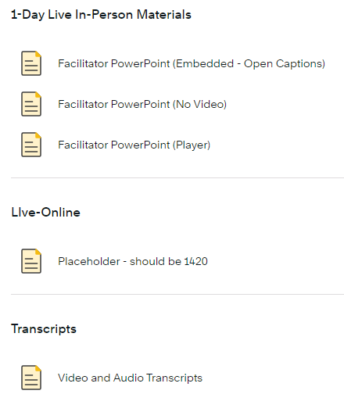
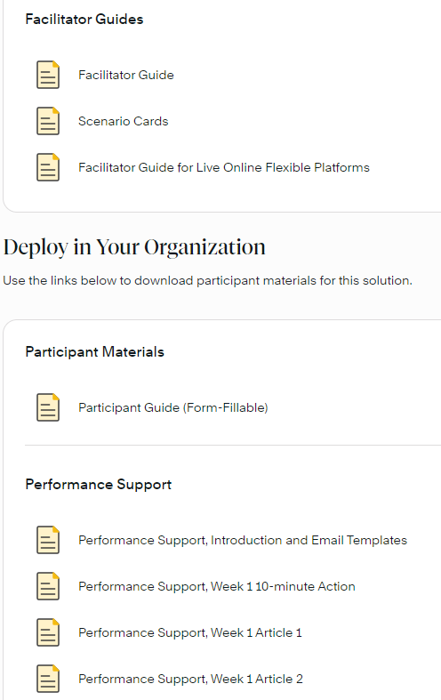
Prepare to Deliver:
What’s next after getting certified?
All Facilitator Resources are in the Facilitator Tab
Participant Guides can be downloaded and sent to learners digitally or learners have access to them from their Learner Platform. See directions below on how Learners can access Participant Guides from their Learner Platform
Physical Participant Guides/Kits are also available upon request
These are generally used for Live In-Person Facilitation and are $45 per kit for all courses
Please reach out to Madalyn.Budzik@FranklinCovey.Com for physical kits, pricing and invoicing.
DIRECTIONS ON HOW LEARNERS CAN DOWNLOAD/PRINT THE PARTICIPANT GUIDE
Click here to go to your Learner Platform: Learner Platform
Go to the Explore Tab and Search what course you want download/print the participant guide from
Click on that course and scroll all the way down to Additional Resources
Click on Tools and Cards
Open up the Participant Guide and save this. You will use this guide throughout the course
See next slide for Facilitator Best Practices

Slide 15
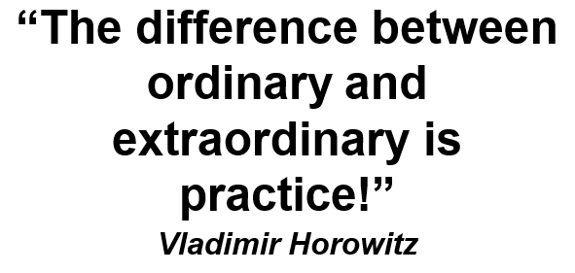
Facilitation Best Practices
Watch all videos, twice…
Once from the lens of a learner
Once from the lens of a facilitator
“Enhance your Facilitator Guide, e.g.”
Generate relevant work examples that will apply to your learners
Complete all the participant guide exercises yourself
Jot down contingency plans to help you in a time crunch. (e.g. if time runs short, have participants complete Application Exercise questions 1 & 3 only.)
Do a practice session with 2-3 colleagues
Co-Facilitate with a peer
Prepare for plan B if learners do not attend
Create plan for either a make-up class or OnDemand learning they can do. Your Implementation Strategist can help with this as well
See next slide for additional Facilitator Best Practices

Slide 16
Facilitation Best Practices Continued…
Questions to ask yourself for prepping:
Is there any pre-work needed to get out?
Do I need to communicate any information to participants?
Do I have my facilitation days all set up?
Do I have my follow-up/re-cap plan all set?
Do I need any support from FranklinCovey?
Did I do a run-through with the PPT slides and make sure the network settings are all good?
Do I need a “producer” for live online or live in-person helper to direct questions and help with technical issues?
Train the Trainer: An additional option is to hire a FranklinCovey Consultant to do a train-the-trainer session. You can choose to:
Observe
Co-Facilitate
Be Coached
Email vacare@franklincovey.com to learn more about pricing and working with a FranklinCovey Consultant!
This site contains some great facilitator videos on body language and visual facilitation: Engage with us.
(Scroll to the bottom of the page)

Slide 17
Reporting After Your Delivery:
Usage is key to the success of any contract. Any time you share any FranklinCovey resource with a learner who isn’t actively logged in, we are unable to track their usage. Please report your facility’s utilization in one of the following ways:
TMS
TMS has codes for each of the courses available for instructor led delivery. If you manage registration and completions through TMS, we will be provided a copy of that roster at the end of each month by the National TMS team, and there is no additional action required.
Send Rosters
If you are using manual rosters, please provide a copy to VACare@FranklinCovey.com to ensure your facility usage is reported correctly and that your participants receive continuing education credits. Please include:
Email Addresses for Learners
Name of Certified Instructor
Date of Course
Live Online or Live In-Person
Content Title

Slide 18
Continuing Education Credits
What is a Continuing Education Credit (CEC)?
Learners are eligible to receive Continuing Education Credit for instructor led full courses and select OnDemand Modules.
Please visit this link for a detailed PDF of the content and modules eligible for CEC’s.
If you have additional questions on earning CEC’s, please email VA care at VACare@FranklinCovey.com
If you would like your students to receive CECs for a course you've delivered, please email VACare@FranklinCovey.com with the following information:
First and Last Name of the person that completed the course(s)
Email address of the person that completed the course (s)
Title of the course you completed
The date of the course you completed
Name of the person that Facilitated the course
NOTE: Once you email VACARE with this information, it will take our team about 6 weeks to process the CEC’s and after they have been processed, each individual participant will get an email from FranklinCovey with a link to download their certificate.

Slide 19
Alternative Usage – This is the most critical factor in tracking usage for contract renewal.
What qualifies as Alternative Usage?
Below are a few examples of the types of usage we need your help tracking!
Instructor Led (In-person or Online) - Full or portions of courses. If you track in TMS, no need to double report.
Facilitator Certification Completion of any FranklinCovey Course
If you share ANY content from FranklinCovey (Articles, videos, tools, etc.) during any of the below forums, please let us know:
Lunch and Learns
Town Halls
Flipped Classrooms
Newsletters
Sent via email, MS Teams and other platforms
Posted in digital platform
How to track Alternative Usage:
Any time you identify Alternative Usage within your facility, please let us know so we can award usage to your facility.
Complete the simple survey here.
Approximately when was the content delivered?
How many VHA Employees participated in the training?
What and how did you share the information?
Please reach out to VACare@FranklinCovey.com if you have any questions

Slide 20
Level 4: Expert Engagement
Leadership Development
Program Engagement
The Expert level of Engagement for the FranklinCovey Partnership involves building FranklinCovey content into Leadership Development Programs.
Leadership Development Engagement includes resources up to and including:
Launching 360 Diagnostic in your Development Program
Instructor-lead FranklinCovey Course Delivery
Blended/Flipped Classroom Learning
Utilization of FranklinCovey content/resources in building or supporting in your Development Program
Leadership Development Program
Engagement Resources
Launching 360 Self-Diagnostic
Getting Certified to deliver FranklinCovey courses live in-person or live online
Blended Learning/Flipped Classroom Guides
These blended learning guides support a Facilitator with leading discussion with specific courses that learners are doing OnDemand
Utilization of FranklinCovey content/resources in building or supporting a Leadership Development Program:
Each Leadership Program is unique and different. Please reach out to Lindsay.Jaremba@FranklinCovey.com to support you with strategizing, customizing, developing, and executing FranklinCovey Content within a Leadership Program.

Slide 21
360 Diagnostic Measures more than 25 skills to identify skill gaps, guide learning experiences overtime, and measure outcomes.

Slide 22
Impact Platform 360 Detailed Learner Experience
1:1 Coaching Session
Who: Learner +
FC Exec Coach
Time commitment:
60 minutes
*Additional Cost
Request Feedback
Self-Assessment
Receive Feedback
Begin Impact Journey
Live/Live Online
Spaced
Concentrated
On Demand Learning
Who: Peers, Manager, Direct Reports
Time commitment:
10-15 minutes
Who: Learner
Time commitment:
10-15 minutes
*must have 5+ responses to see results. Recommended 7+ respondents
Self-Directed Review
Who: Learner + FAQs resources
Time commitment:
30 minutes
Program Launch
*Additional option to opt into self-directed micro course and/ or other asynchronous learning
Launch 4 weeks+ before journey. Raters given 10 days, 2 reminder emails

Slide 23
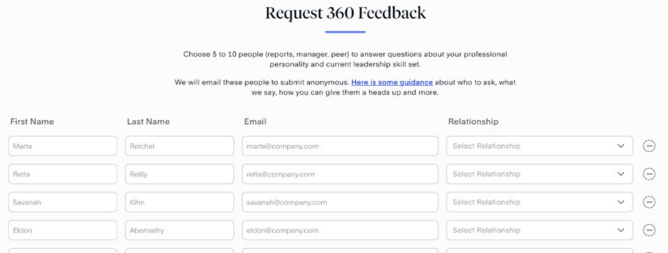
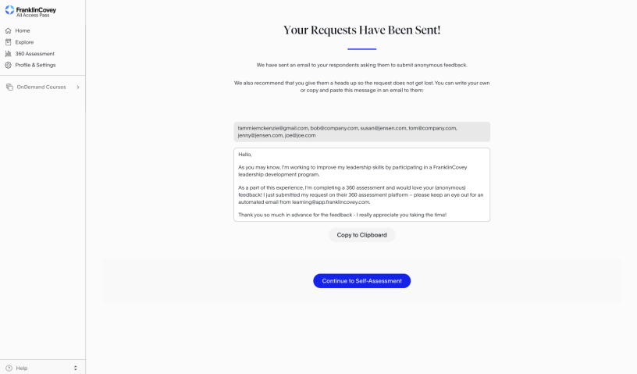
Detailed 360 Process Flow
Request Feedback:
Learners request feedback from 5 or more managers, peers, direct reports, and cross-functional partners. Respondents can be from outside of VHA.
The collection process is easy – learners add respondents contact information and hit submit.
After the respondents are entered, the learner will have the opportunity to copy an email to personalize for respondents.
Self-Assessment:
After the email to respondents, the Learner will begin the self-assessment
Learners will take the assessment based on what role they are in the Impact Platform (Manager or Individual Contributor)

Slide 24
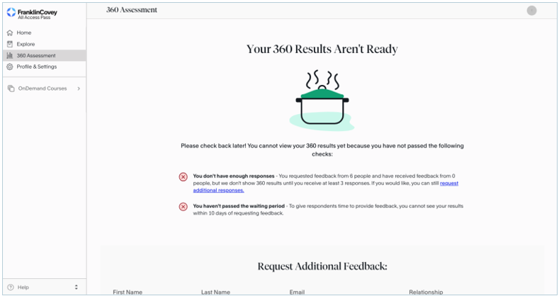
Detailed 360 Process Flow Continued:
Receive Feedback:
Respondents have 10 days to respond and will receive 2 reminder emails.
If the Learner doesn’t get 3 responses in 10 days, they can request additional feedback.

Slide 25
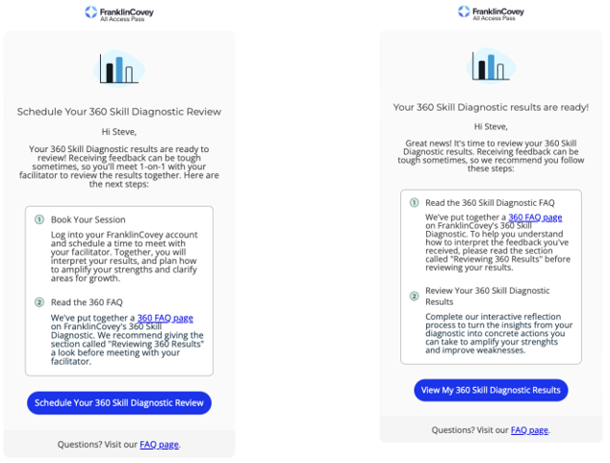
Detailed 360 Process Flow Continued
Results are Ready!
When results are ready, the Learner receives an email letting them know to either schedule their coaching reveal (additional charge) or complete a self-reveal.
Learners can do 1 of 2 options:
Self-Directed Review:
Learners will be prompted to complete a self-directed review on the Impact Platform that encourages them to reflect on their results. This 15-minute review is optional for learners who have a 360 Coaching Session.
360 Coaching Session (Additional Charge):
Accelerate performance by partnering learners with a FranklinCovey Coach. Coaches are an optional service that allows learners to dive deeper into their results with an expert. During their time together, learners identify key skills that target growth and personalize learning.

Slide 26
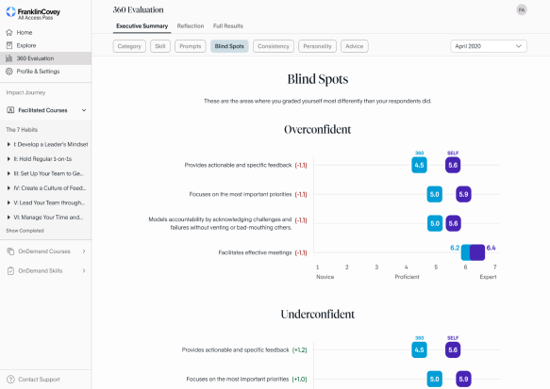
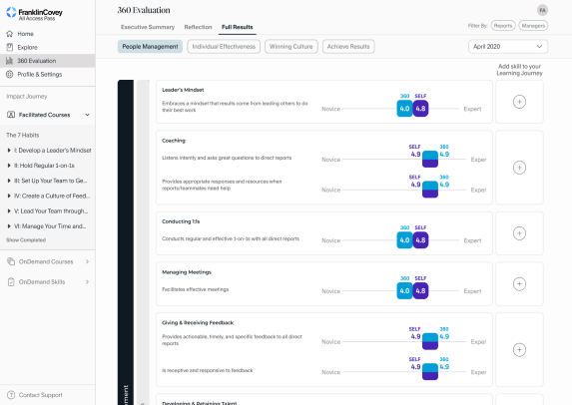
Detailed 360 Process Flow Continued
Begin Impact Journey!
Learners can subscribe to Microcourses from their 360 diagnostic results by clicking “Subscribe to Microcourse” next to the desired skill.
Microcourses are self-paced, skill-specific learning resources that help learners adopt new, effective mindsets and behaviors by investing only a few minutes per week. Microcourses consist of brief videos, articles, tools, and application challenges push out over a three-week period, so learners can increase their capabilities over time for lasting impact.

